Slide 1

Title of your paper
Subtitle of your paper
Main finding statement (as short as possible) translated into plain English. Emphasise key words.
EXTRA INFORMATION BAR
Extra Information Bar
Replace this with your:
Extra Graphs
Extra Correlation tables
Extra Figures
Extra nuance that you’re worried about leaving out.
This section is mainly for you to use when you are having a conversation and need to refer to specific data.
Your Name
BACKGROUND
Explain why your study matters in the fastest, most brutal way possible. Feel free to add graphics!
METHODS
Collected [what] from [population]
Tested it with X process.
Illustrate your methods if you can with charts and images.
Try a flowchart!
TABLE 1
Keep the table and Graph titles as short
TABLE 1
Keep the table and Graph titles as short
Create an image that helps illustrate your findings
with a chart, table, graphic, or a key figure.
CONGRESS STREAM
Insert Congress Stream
AUTHORS / ACKNOWLEDGEMENTS
Person 1, Person 2, Person 3…

Slide 2
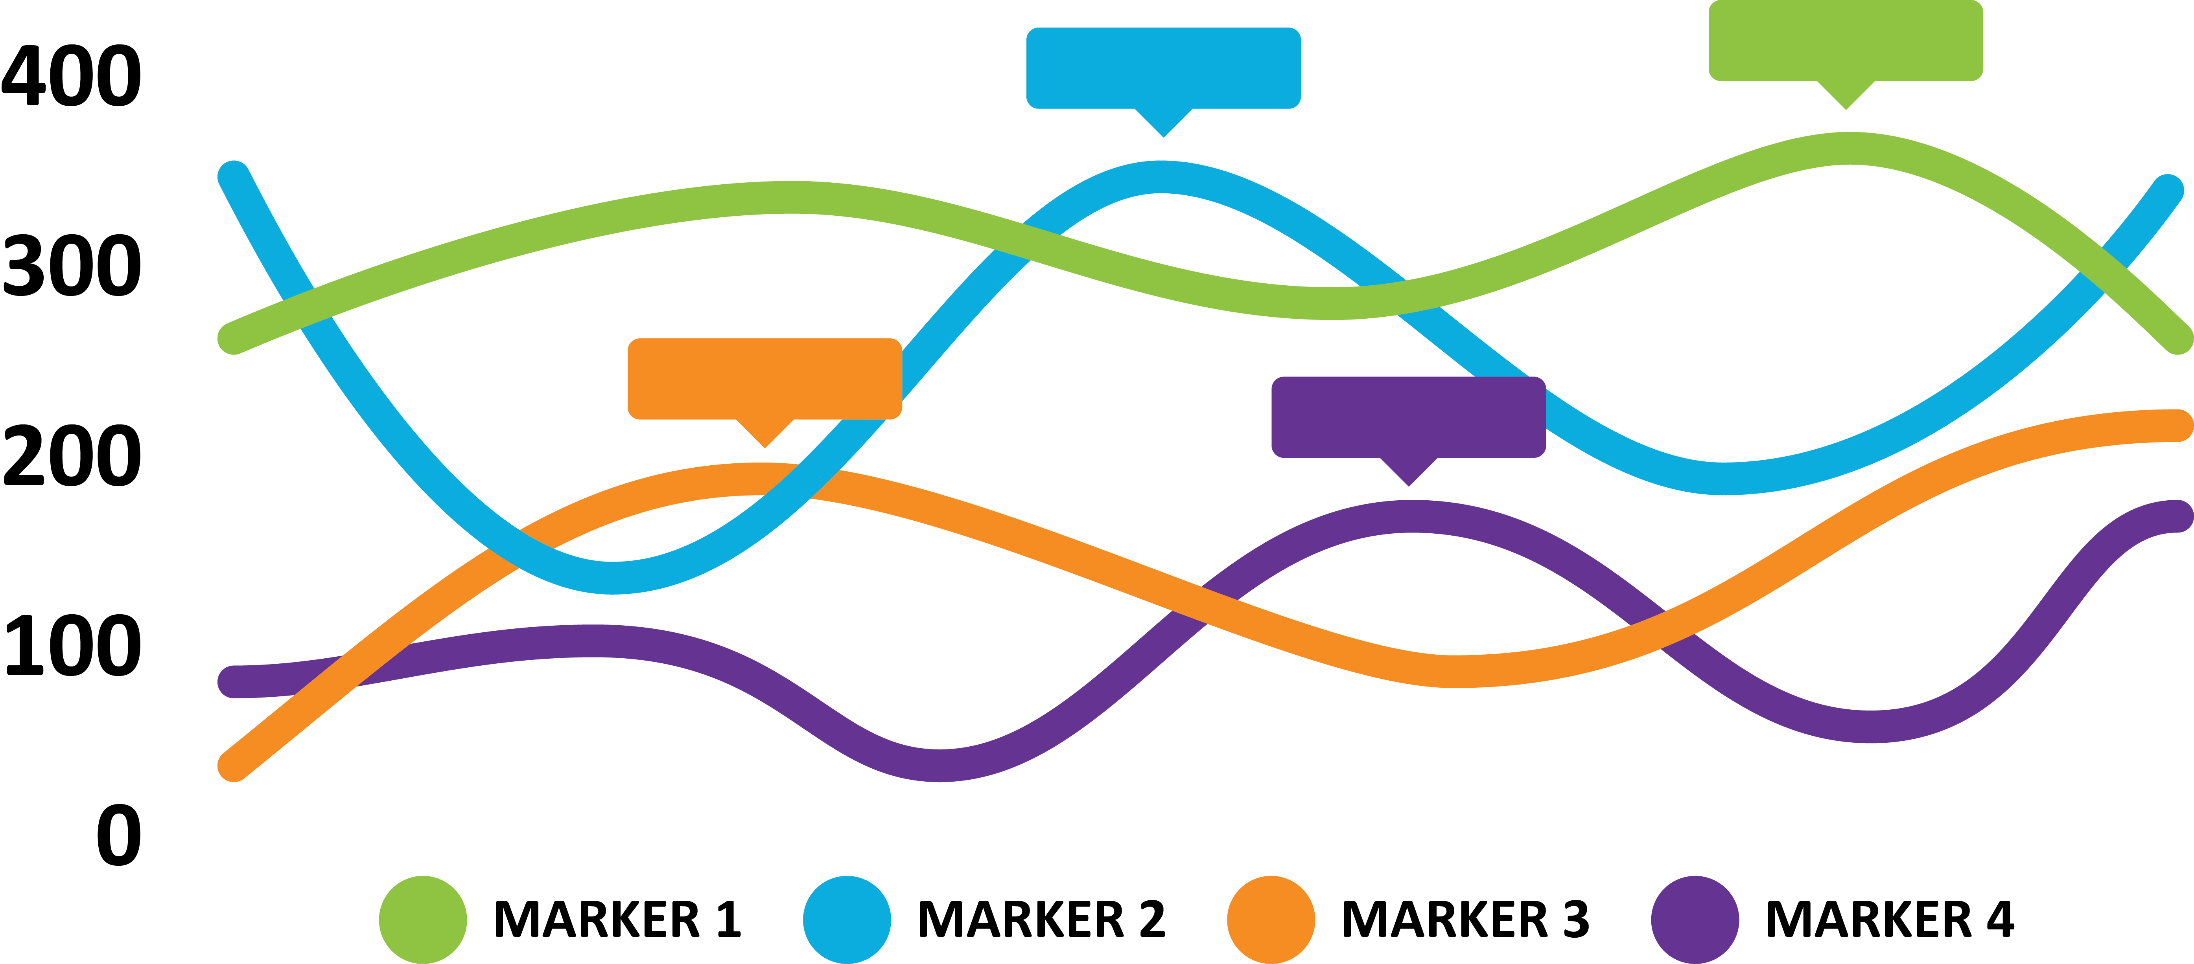
Title of your paper
Subtitle of your paper
Your Name
You have five seconds to convey your most important point as people walk by.
BACKGROUND
Explain why your study matters in the fastest, most brutal way possible. Feel free to add graphics!
METHODS
Collected [what] from [population]
Tested it with X process.
Illustrate your methods if you can with charts and images.
Try a flowchart!
TABLE 1
Keep the table and Graph titles as short
TABLE 1
Keep the table and graph titles as short
CONGRESS STREAM
Insert Congress Stream
AUTHORS / ACKNOWLEDGEMENTS
Person 1, Person 2, Person 3…

Slide 3
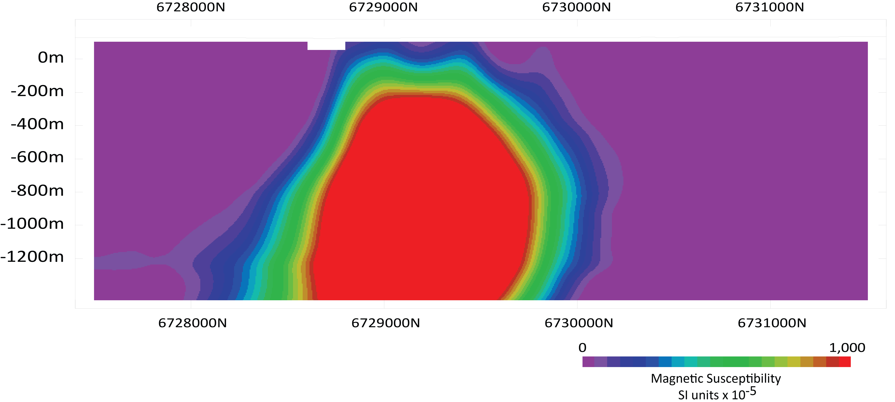

r
Title of your paper
Subtitle of your paper
Your Name
Background
Explain why your study matters in the fastest, most brutal way possible. Feel free to add graphics!
Methods
Collected [what] from [population]
Tested it with X process.
Illustrate your methods if you can with charts and images.
Try a flowchart!
You have five seconds to convey your most important point as people walk by.
r
r
Key Geological Findings
NS SECTION 485000 mE
Explain carefully in plain English what is significant about your findings that is illustrated with your chart or image.
TABLE 1
Keep the table and Graph titles as short
CONGRESS STREAM
Insert Congress Stream
AUTHORS / ACKNOWLEDGEMENTS
Person 1, Person 2, Person 3…

